Slide 1


Virtual Commissioning
Transfer system TS2
Requirement Specification

Slide 2
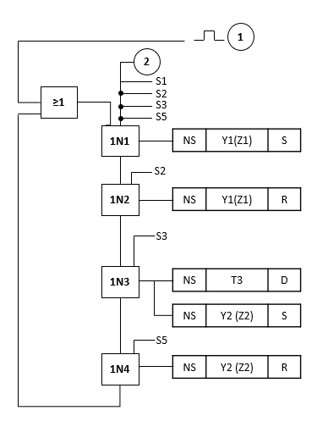
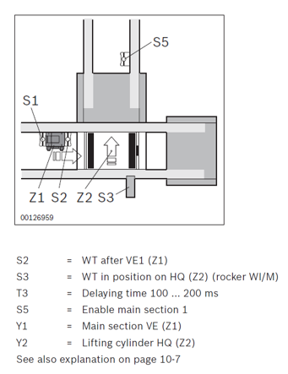
Requirement Specification
Development of TS2 Library
Evaluation TFE Product Catalogue > Which TFEs exist?
Function Plans for TS2 LTU:
TFE1: Implementation in transverse section

Slide 3
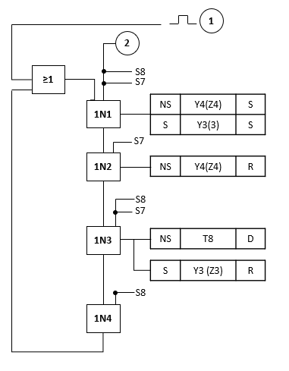
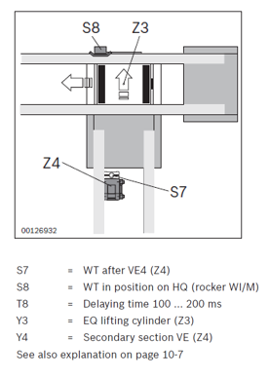
Requirement Specification
Development of TS2 Library
Evaluation TFE Product Catalogue > Which TFEs exist?
Function Plans for TS2 LTU:
2. TFE2: Implementation in longitudinal section

Slide 4
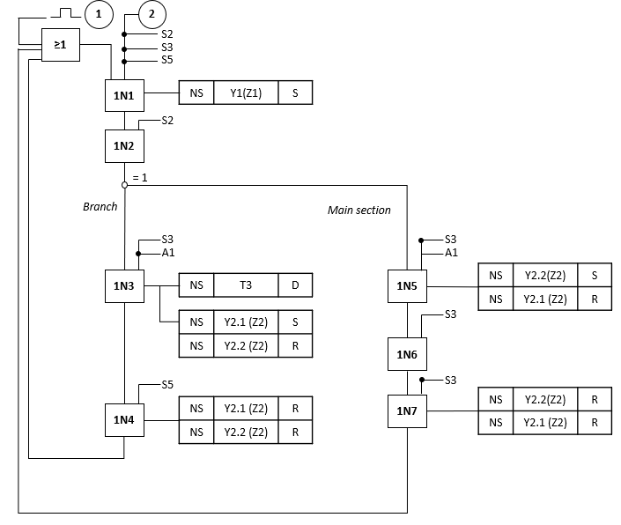
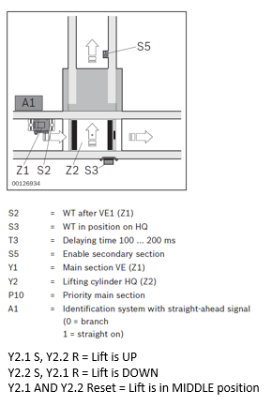
Requirement Specification
Development of TS2 Library
Evaluation TFE Product Catalogue > Which TFEs exist?
Function Plans for TS2 LTU:
3. TFE3: Transverse conveyor (separating, outfeeding)

Slide 5
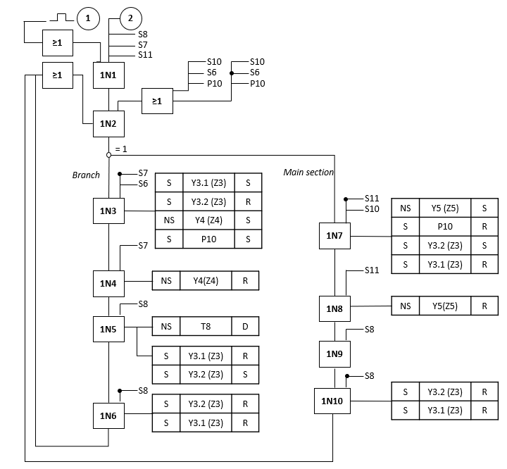
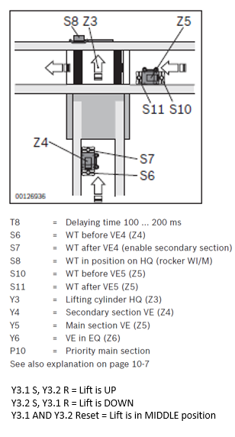
Requirement Specification
Development of TS2 Library
Evaluation TFE Product Catalogue > Which TFEs exist?
Function Plans for TS2 LTU:
4. TFE4: Transverse conveyor (separating, infeeding)

Slide 6
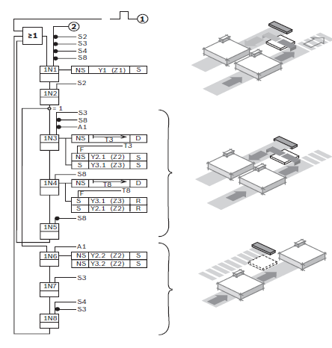
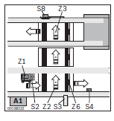
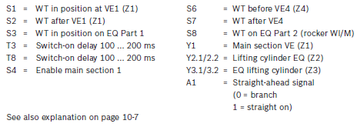
Requirement Specification
Development of TS2 Library
Evaluation TFE Product Catalogue > Which TFEs exist?
Function Plans for TS2 LTU:
5. TFE5: Transverse conveyor EQ 2/TR (separating, outfeeding)
TFE2
TFE3

Slide 7
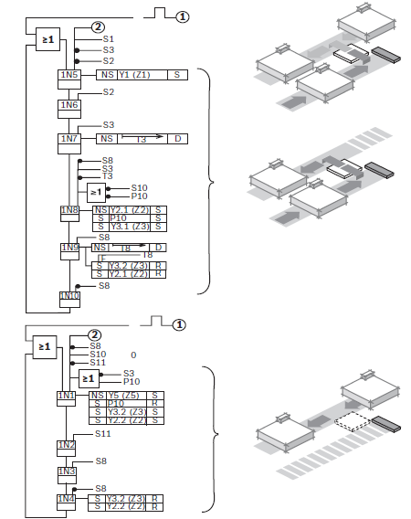
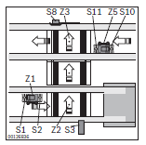
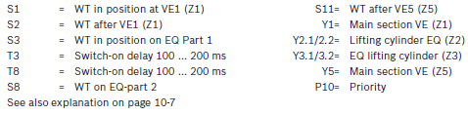
Requirement Specification
Development of TS2 Library
Evaluation TFE Product Catalogue > Which TFEs exist?
Function Plans for TS2 LTU:
6. TFE6: Transverse conveyor EQ 2/TR (separating, infeeding)
TFE4
TFE1

Slide 8
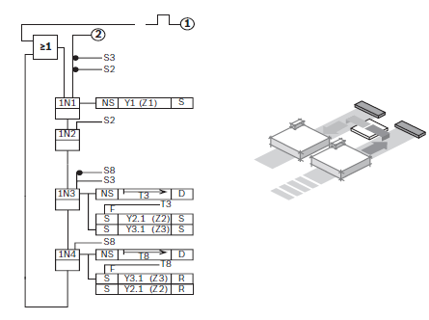
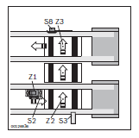
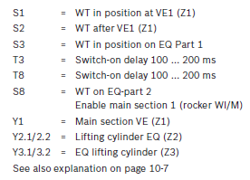
Requirement Specification
Development of TS2 Library
Evaluation TFE Product Catalogue > Which TFEs exist?
Function Plans for TS2 LTU:
7. TFE7: Transverse conveyor EQ 2/TR (transfer) (TFE 7)
TFE2
TFE1

Slide 9
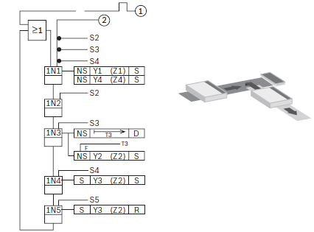
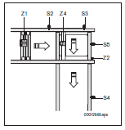
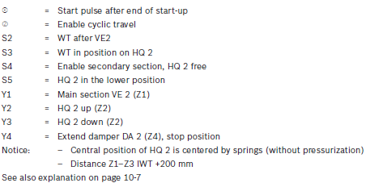
Requirement Specification
Development of TS2 Library
Evaluation TFE Product Catalogue > Which TFEs exist?
Function Plans for TS2 LTU (HQ 2/C-H, HQ 2/G-H):
TFE1: Implementation in transverse section

Slide 10
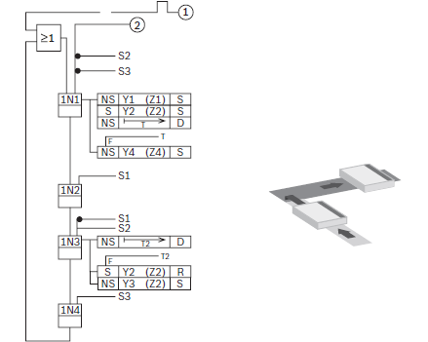
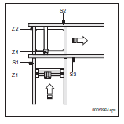
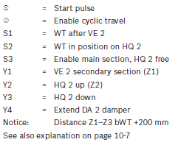
Requirement Specification
Development of TS2 Library
Evaluation TFE Product Catalogue > Which TFEs exist?
Function Plans for TS2 LTU (HQ 2/C-H, HQ 2/G-H):
2. TFE2: Implementation in longitudinal section

Slide 11
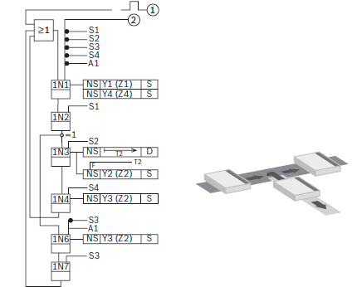
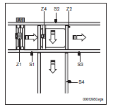
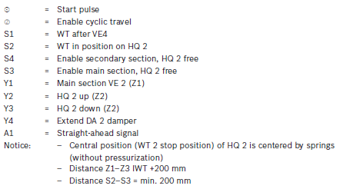
Requirement Specification
Development of TS2 Library
Evaluation TFE Product Catalogue > Which TFEs exist?
Function Plans for TS2 LTU (HQ 2/C-H, HQ 2/G-H):
3. TFE3: Outfeeding from longitudinal conveyor

Slide 12
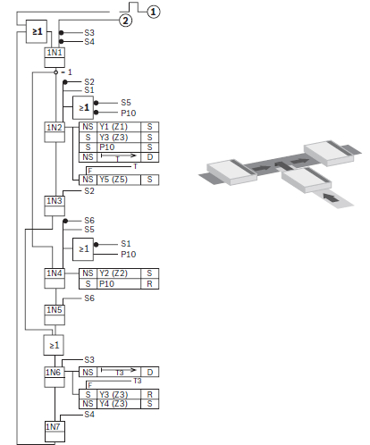
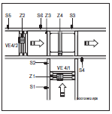
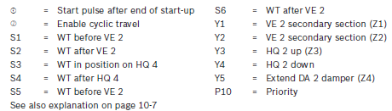
Requirement Specification
Development of TS2 Library
Evaluation TFE Product Catalogue > Which TFEs exist?
Function Plans for TS2 LTU (HQ 2/C-H, HQ 2/G-H):
4. TFE4: Infeeding to longitudinal conveyor

Slide 13
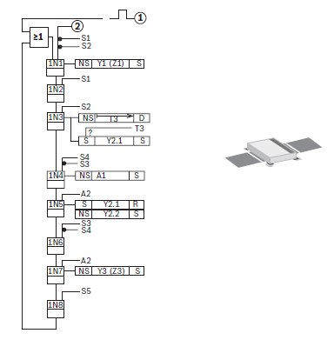
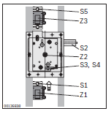
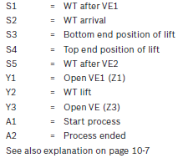
Requirement Specification
Development of TS2 Library
Evaluation TFE Product Catalogue > Which TFEs exist?
Function Plans for TS2 Position Unit:
1. Conveyor function unit PE

Slide 14
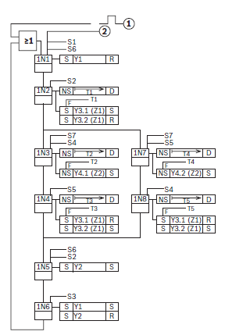
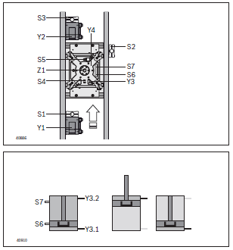
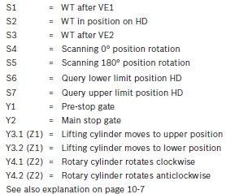
Requirement Specification
Development of TS2 Library
Evaluation TFE Product Catalogue > Which TFEs exist?
Function Plans for TS2 Lift Rotate Unit:
1. Function plan HD 2/H (BG1, BG2, BG3), ROTATION ANGLE 180°

Slide 15
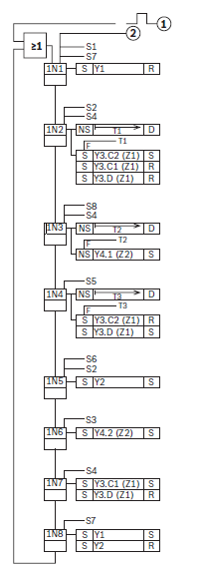
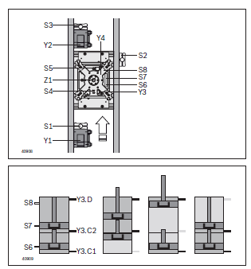
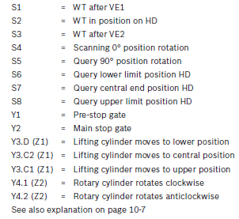
Requirement Specification
Development of TS2 Library
Evaluation TFE Product Catalogue > Which TFEs exist?
Function Plans for TS2 Lift Rotate Unit:
2. Function plan HD 2/H (BG1, BG2), ROTATION ANGLE 90° (NOT TIME-OPTIMIZED)

Slide 16
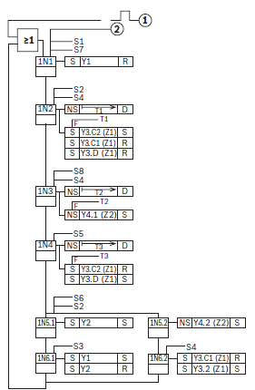
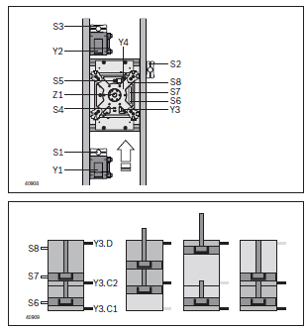
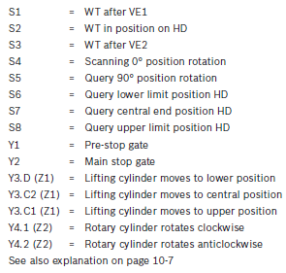
Requirement Specification
Development of TS2 Library
Evaluation TFE Product Catalogue > Which TFEs exist?
Function Plans for TS2 Lift Rotate Unit:
3. Function plan HD 2/H (BG1, BG2), ROTATION ANGLE 90° (TIME-OPTIMIZED)

Slide 17
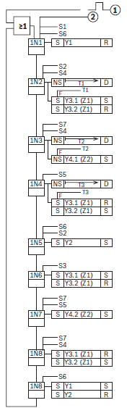
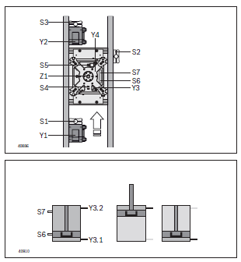
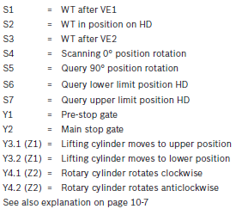
Requirement Specification
Development of TS2 Library
Evaluation TFE Product Catalogue > Which TFEs exist?
Function Plans for TS2 Lift Rotate Unit:
4. Function plan HD 2/H (BG3), ROTATION ANGLE 90°

Slide 18
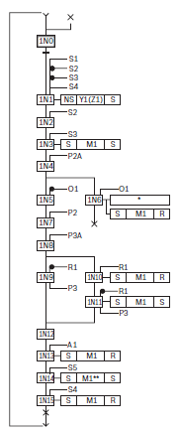
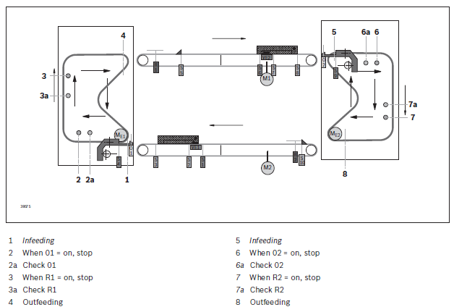
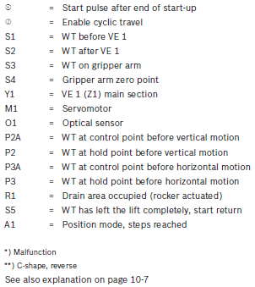
Requirement Specification
Development of TS2 Library
Evaluation TFE Product Catalogue > Which TFEs exist?
Function Plans for TS2 Elevator EL2:
1. Lift EL 2 (infeeding + outfeeding)

Slide 19
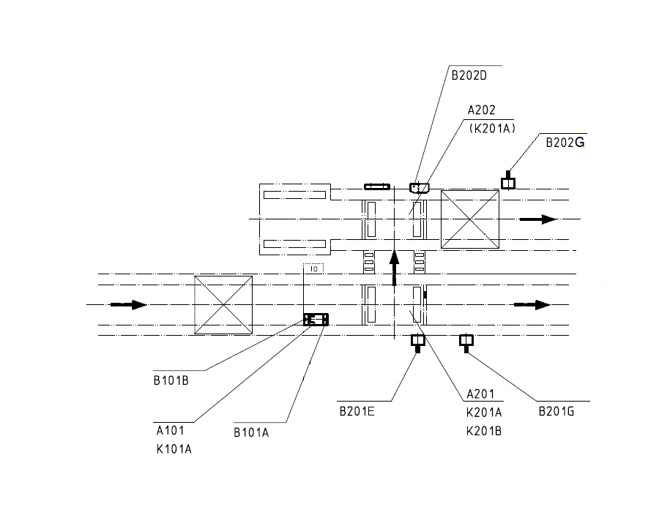

Requirement Specification
Development of TS2 Library
Evaluation TFE Product Catalogue > Which ones are missing and must be covered?
Additional TFEs for TS2 LTU :
1.
Combination of:
•TFE3 and
•TFE2 (w/o entry SG)
TFE2
TFE3

Slide 20

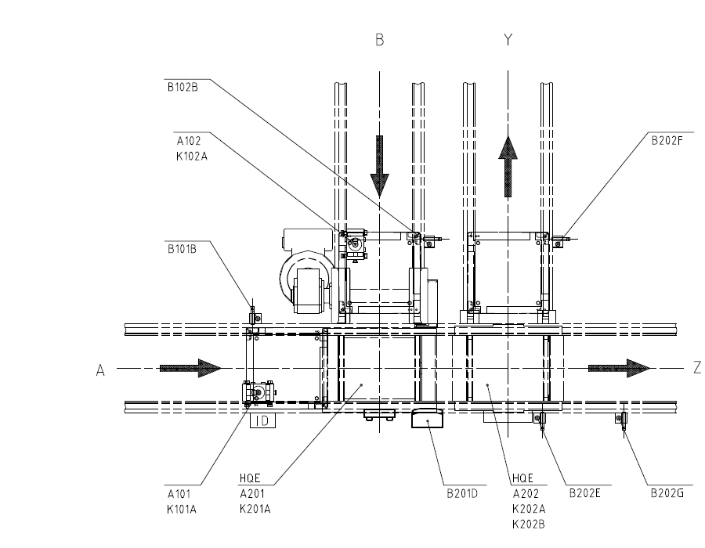
Requirement Specification
Development of TS2 Library
Evaluation TFE Product Catalogue > Which ones are missing and must be covered?
Additional TFEs for TS2 LTU :
2.
Combination of:
•TFE4 and
•TFE3 (w/o entry SG)
TFE4
TFE3

Slide 21

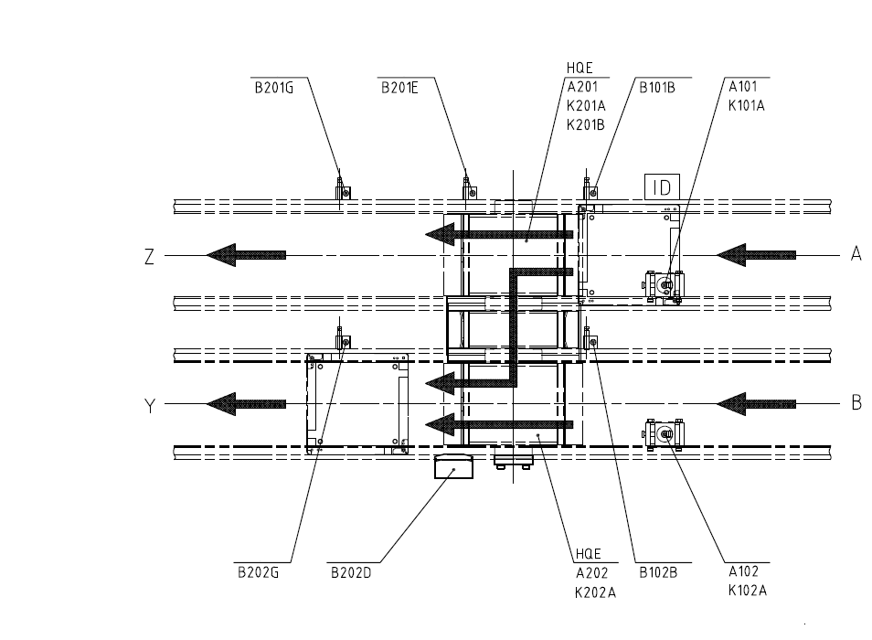
Requirement Specification
Development of TS2 Library
Evaluation TFE Product Catalogue > Which ones are missing and must be covered?
Additional TFEs for TS2 LTU :
3.
Combination of:
• TFE4 (w/o branch entry SG) and
• TFE3 (w/o branch exit Sensor)
TFE3
TFE4

Slide 22


Requirement Specification
Development of TS2 Library
Evaluation TFE Product Catalogue > Which ones are missing and must be covered?
Additional TFEs for TS2 LTU :
4.
TFE3+4
• A bit more complex and might need a separate TFE.
TFE3+4

Slide 23


Requirement Specification
Development of TS2 Library
Evaluation TFE Product Catalogue > Which ones are missing and must be covered?
Additional TFEs for TS2 LTU :
5.
Combination of:
• TFE4 (w/o entry SG) and
• TFE3
TFE3
TFE4 (w/o entry SG)

Slide 24


Requirement Specification
Development of TS2 Library
Evaluation TFE Product Catalogue > Which ones are missing and must be covered?
Additional TFEs for TS2 :
1.
Capacity based control

Slide 25
Requirement Specification
Development of TS2 Library
Evaluation TFE Product Catalogue > Which ones are missing and must be covered?
Summary:
Except for the node involving TFE 3+4 , other additional TFEs listed before can be implemented using existing basic four TFEs for the LTU.

Slide 26
Requirement Specification
Development of TS2 Library
Functional Requirements Simulation Objects
>Which simulation objects are necessary?
>Which ones are missing in the existing simulation library in Visual Components?
All components of TS2 system library are tabulated and missing simulation components are listed down (see Table: TS2 Components)

Slide 27
Requirement Specification
Development of TS2 Library
Component | Variant | Function plan available in product catalogue? | Simulation Object Available? | Comments
Lift Transverse Unit | HQ 2/T | Yes | Yes
 | HQ 2/S | Yes | Yes
 | HQ 2/O | Yes | Yes
 | HQ 2/U-U2 | Yes | Yes
 | HQ 2/U-H | Yes | Yes
 | HQ 2/C-H | Yes | Yes | • Use of stop gate object VE 2/D100 or VE 2/D250 or VE 2/D410, and Damper in Function plan (Components missing) • Applicable for widths > 400mm • Material flow to be confirmed. (If sequence of flow is same, no change required to existing component).
 | HQ 2/G-H | Yes | Yes | • The above applies here as well.
Stop Gate | VE 2 | NA | Yes | • Do we need additional SG as mentioned above?
Switch Bracket | SH 2 | NA | Yes
Slide Stop | VA 2 | NA | No
Scraper |  | NA | No
Rocker | WI 2 | NA | No
Damper | DA 2 | NA | No
Electrical Transverse Conveyor | EQ 2/TR | Yes | No | • Can be realised using existing LTU and belt section. • Corresponding function plans can be modelled using existing TFEs.
 | EQ 2/TR-90 | No | No
 | EQ 2/T | No | No
 | EQ 2/TE | No | No
Position Unit | PE | Yes | Yes | • Signal evaluation required
 | HP | Yes | Yes | • Signal evaluation required
Elevator | EL 2 | Yes | Yes | • Signal evaluation required
Lift Rotate Unit | HD | No | Yes | • Signal evaluation required
 | HD2/H | Yes | Yes | • Signal evaluation required
Rotate Unit | DE 2 | No | Yes | • Signal evaluation required
Belt Section | BS 2 | NA | Yes
Conveyor unit | AS 2/ | NA | Yes
Curve 2/90 | CU 2/90 | NA | Yes
Curve 2/180 | CU 2/180 | NA | Yes
Legset | SZ 2 | NA | Yes
Table 1 : TS2 Components and availability of simulation object/function plans

Slide 28
Requirement Specification
Development of TS2 Library
Sl.No | Functional Requirements Simulation Objects
1 | The following list of TS2 components should be available as simulation objects in Visual Components: • Lift transverse unit • Stop gate • Switch bracket • Position Unit • Elevator • Lift rotate unit • Rotate unit • Belt Section • Conveyor unit • Curves Detailed list of available components are in "List of TS2 Components".
2 | The simulation objects should have behavior and signals as described in product catalogue.
3 | The following objects should be modified(properties,signals,functionality,python code): • Lift transverse unit • Stop gate • Position Unit • Elevator • Lift rotate unit • Rotate unit Detailed description of modification required described in "List of to be modified Sim Obj".

Slide 29
Requirement Specification
Development of TS2 Library
Functional Requirements Simulation Objects
> Which objects must be modified (properties, signals, functionality, Python code, ...)?
Simulation Object | Modifications Required
Lift transverse unit | • Addition of 3 lift states (Up,Down,Middle) and corresponding moveLift signals. • Implementation of grabbing WPC with liftContainer to move WPC along with the lift. • Behaviour implementation: WPC moves forward only when lift is Down. • Behaviour implementation: WPC enters the LTU without manual trigger of powerOnRolls.
Stop gate | • Addition of missing signal to detect WPC after stopper.
Position Unit | • Addition of missing signals: S2-WPC at middle signal S3- LiftStateDown signal S4-LiftStateUp signal A1-Start process A2- Process ended • Additional signal control mode similar to LTU.
Elevator | • Addition of multiple missing signals.
Lift Rotate Unit | • Addition of multiple missing signals: S2-WPC in position(middle signal) S4-Scanning 0° position rotation S5-Scanning 180° position rotation S6-Lower limit state signal Central position state signal S7-Upper limit state signal MoveLiftUp signal MoveLiftDown signal MoveLiftCenter signal RotaryCylinder rotate CW RotaryCylinder rotate CCW
Rotate Unit | • Addition of multiple missing signals: MoveToPort1,MoveToPort2,MoveToPort3,MoveToPort4 signals

Slide 30
Requirement Specification
Development of TS2 Library
Functional Requirements PLC Function Blocks
> How can TFEs be conceptually aggregated?
>The target is a minimal amount of (configurable) function blocks, to each TFE can be realized by one of these function blocks.
Which distribution and aggregation rules for configurable material flow controls must be defined?
> Functional description of PLC function blocks
After careful evaluation, all the possible use cases for LTU routing were listed down (see previous slides) including existing basic ones from the product catalogue as well as special use cases and how these can possibly be realized using existing TFEs.
The aim is to realize most of these special use cases with the combination of these basic four TFEs namely TFE1,TFE2,TFE3 and TFE 4 with minimal changes in already implemented PLC function blocks.

Slide 31
Requirement Specification
Development of TS2 Library
Functional Requirements PLC Function Blocks
Sl.No | Functional Requirements PLC Function Blocks
1 | List of all function plans defined in the product catalogue should be made.
2 | List of additional TFEs to realize components' special use cases that are not specified in product catalogue should be made.
3 | PLC FBs defining existing function plans of TS2 components from the product catalogue should be developed.
4 | The basic FBs should be configurable and complex TFEs shall be realized by these basic configurable FBs.
5 | Standard distribution and aggregation rules shall be possible using the standard configurable FBs.(eg. Cyclic, Specific pattern, Capacity based etc.)
6 | The FBs should have early evaluation of error handling.

Slide 32
Requirement Specification
Development of TS2 Library
Functional Specification Sheet
Which threats and risks analysis for the development might occur?
If these special use cases cannot be realized by using the basic configurable function blocks, individual FBs should be defined to realize each specific use case resulting in higher development effort.
Since simulation objects like Lift rotate unit, Rotate unit, Position unit, Lift elevator lacks the signals defined in the existing function plans, each object needs to be modified by adding these missing signals to make it VCOM ready.
Performance concern (possible communication delays) when realizing larger layouts.

Slide 33
Requirement Specification
Development of TS2 Library
Functional Specification Sheet
Which simulation objects and function blocks with which properties and capabilities are necessary? > Summary of development effort, necessary capabilities, and project risks.
No additional simulation objects required*.
Additional FB might be required to realize complex LTU use case using two TFE 3+4.
Automating or reducing effort in variable mapping.
Simulation side development effort: Adding missing signals to objects - Lift rotate unit, Rotate unit, Position unit, Lift elevator. Modification if necessary to accommodate configurable FBs.
PLC side development effort: Modification to existing FBs so that it can be used in combination to realize special use cases, developing additional FBs for nodes that cannot be realized using the existing basic FBs.
(*Only if EQ2 can be realized using LTU and belt section and HQ 2 C-H, HQ 2 G-H is not required, ie. no damper object required).

Slide 34
Requirement Specification
Development of TS2 Library
Functional Specification Sheet
Which threats and risks analysis for the development might occur?
Project Scope:
Overview:
Development Effort:
Capabilities:
Risks:

